Slide 2
ABC’s of ADU’s
Agenda
Welcome-Intro-opening remarks-Rocky Martin
Jim Jarvis-Hinesburg Zoning Administrator will review process to obtain Local Permit
Jason Barnard-Environmental Consultant with Barnard and Gervais will review process to obtain State water/wastewater permit
Chuck Reiss-Local builder with Reiss Building and Renovation will review construction process

Slide 3
What is an ADU
Accessory Dwelling Unit-Accessory Apartment (in Hinesburg Zoning)-Accessory Structures-Mother in Law Apartment All the same thing
An ADU is a small residence that shares a single family residential lot with a larger primary dwelling.
Any single family residential home has potential to add separate living quarters on the same lot.
An ADU has to provide for independent living with separate kitchen,bathroom and bedroom.
Could be part of the single family home (basement/attic apartment or converted attached garage; an addition to the home or a completely separate building.

Slide 4
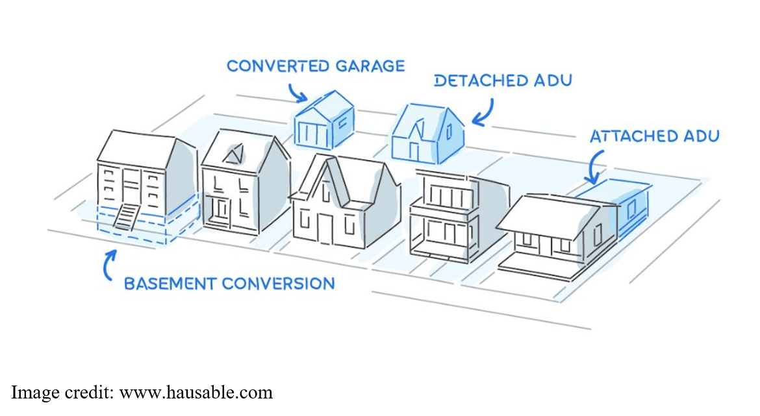
Single Family

Slide 5
Reasons to Consider an ADU
Provide much needed affordable housing especially here in Chittenden County and especially for young folks and seniors.
Provide rental income to help with mortgage and/or property taxes.
Provide residence for family member who could not live independently.
Allow older folks to age in place.
Increase housing supply without using additional land

Slide 6
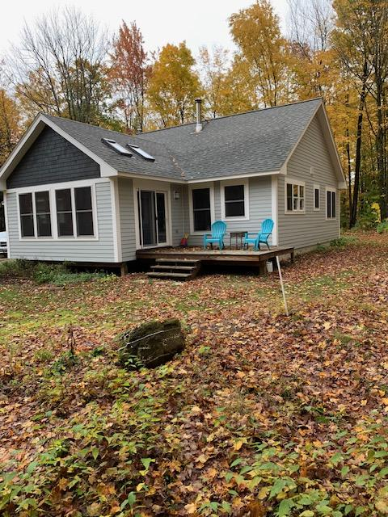

Slide 7
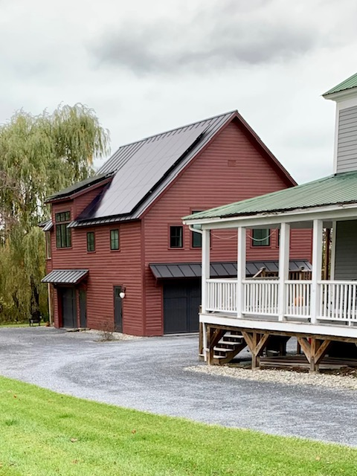

Slide 8
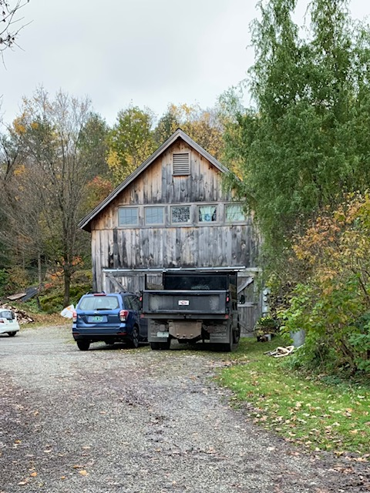

Slide 9
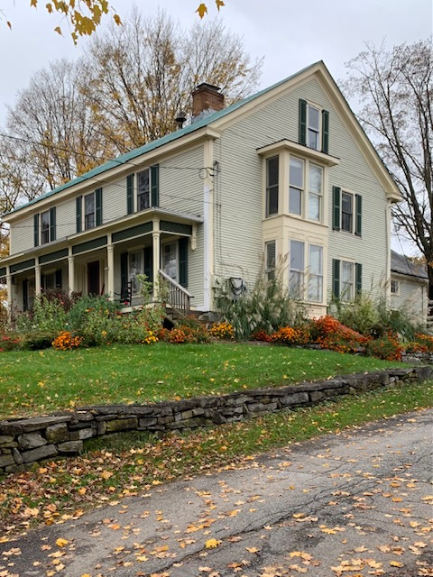

Slide 10
