Slide 2
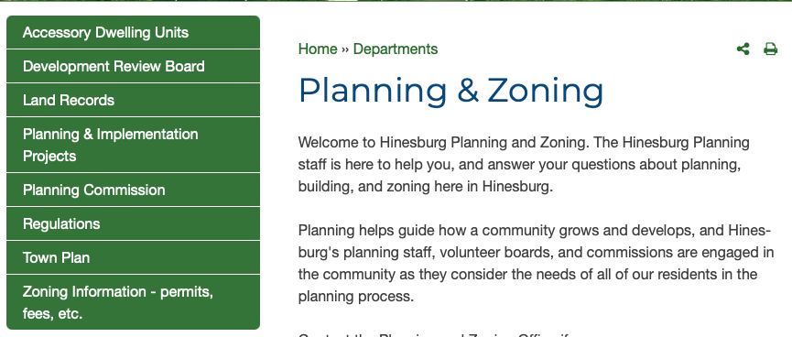

Slide 10
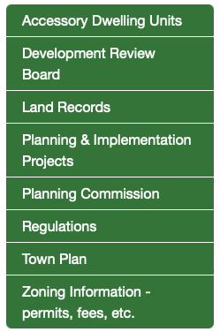
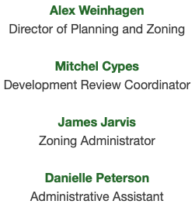
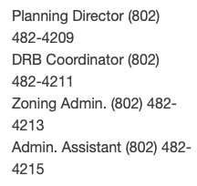

Slide 11
After you have a sense of the process and an idea of what you’d like to create,
the first step is to figure out how to address water/wastewater needs and get the
Necessary Vermont water/wastewater permit. You will likely need to hire a licensed
Designer to evaluate your present system, or design a new system for the ADU.
With that said, here’s an expert on the topic: Jason Barnard.

